Slide 1


WA Super - Presentation 2
20 February 2020
Amanda Efendi
Paul Jamieson
Dr. Ritu Gupta
Notes:
Name and logo!

Slide 2
Presentation Outline
Project Outline
Feature Engineering
Exploratory Data Analysis
Modelling Part 1
Modelling Part 2
Results and Implementation
Limitations

Slide 3

1. Project overview
Problem Statement
To identify the key characteristics of a client who is about to exit the superfund in order to prevent their exit with a marketing strategy.
Datasets
Member Data
Benefit Payment Data
Roll-in Data
SuperClick Advice Data
AOL Output Data
Call Centre Data
Seminar Data
Western Financial Data

Slide 4
Process
Literature Review
Data Engineering
Exploratory Analysis
Model Building
Output
Understanding the variables
Cleaning, aggregating and merging
Overall analysis of dataset
Statistical testing of select variables
Find most suitable machine learning algorithm
Improving model
Understanding context of problem
Current Industry conditions

Slide 5
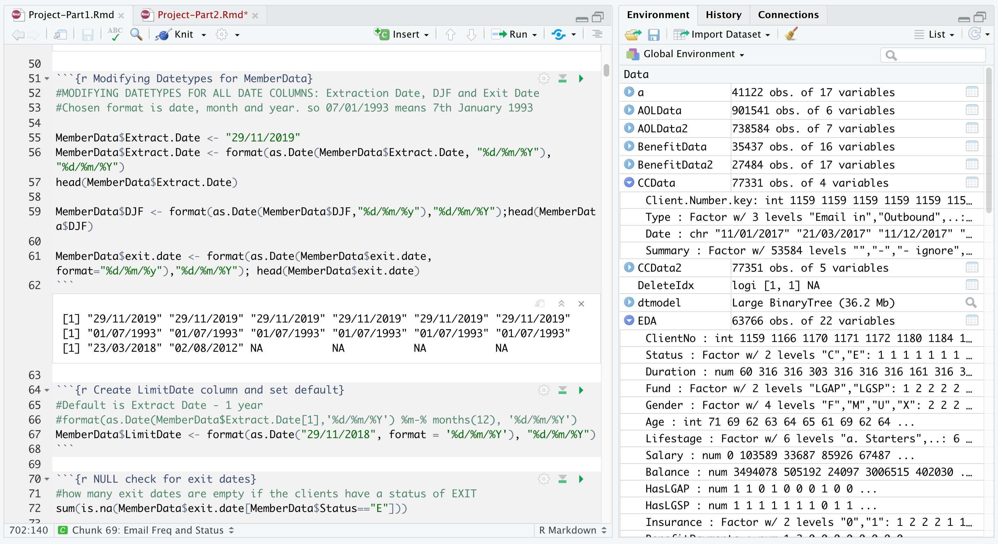
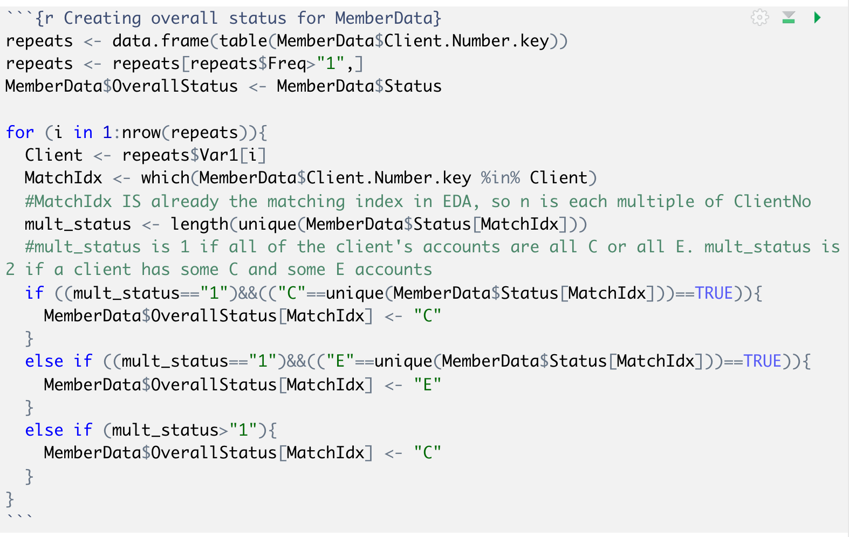
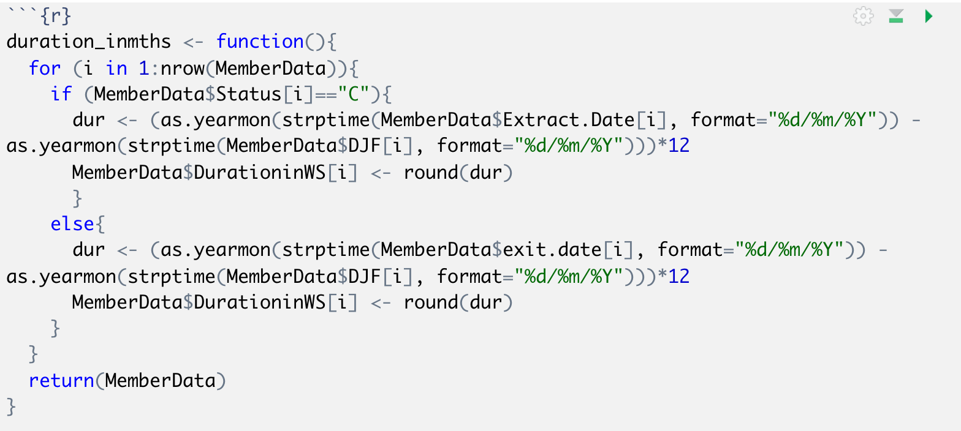
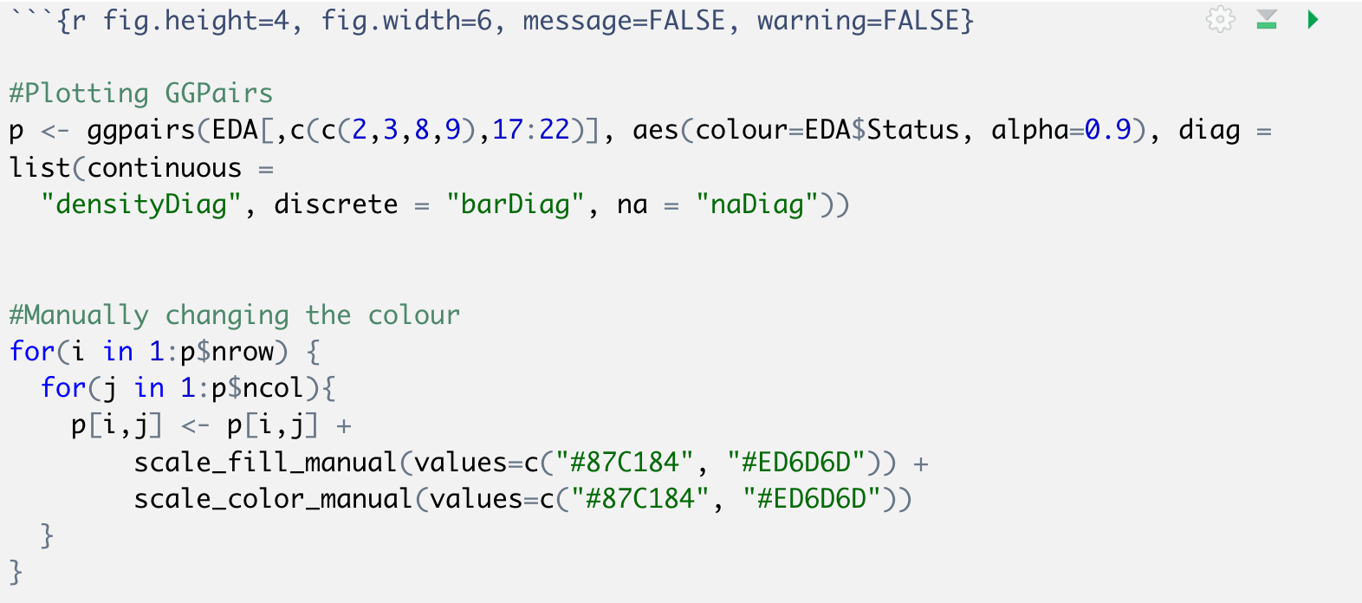
Coding

Slide 6
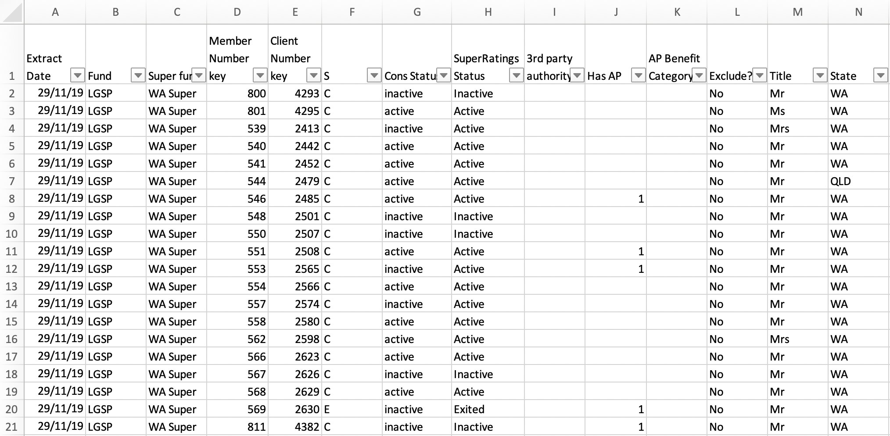
2. Feature Engineering
MemberData.xslx
Dataset Overview: Member Data
101 columns and 71668 rows
General demographic informations
Current and Exit client
Overview of balance and account details such as:
Insurance
Contribution
Roll-ins

Slide 7
2. Feature Engineering
Challenges
Client Number and Member Number both as primary keys
SuperClick, Western Financial, AOL, Call Centre data exception
Deciding on the correct aggregation for some variables (sum or frequency)
LGAP and LGSP account count for client number
Overall client status
Merging multiple dataset with 100+ columns
Outer joins done to preserve observation volume
Notes:
Majority of the datasets used both client and member number as primary key
Meaning that each row in the datasets are only unique by the combination of the two numbers
This is a problem for our modelling process because member number does not represent a single client in the database, but a single account
While client number and member number has a one to many relationship, we had to find a way to make all rows in the final dataset be unique based on ONLY client number
This must be met as other datasets like superclick etc only has client number as their primary key.
With the first challenge, comes the second challenge,
If a client has two accounts, then there will be two rows corresponding to that one client’s data
We cannot afford to lose one of the observations as this will affect the result,
Therefore we had to BLA BLA
Once all the aggregation is done, the datasets were ready to merge together.

Slide 8
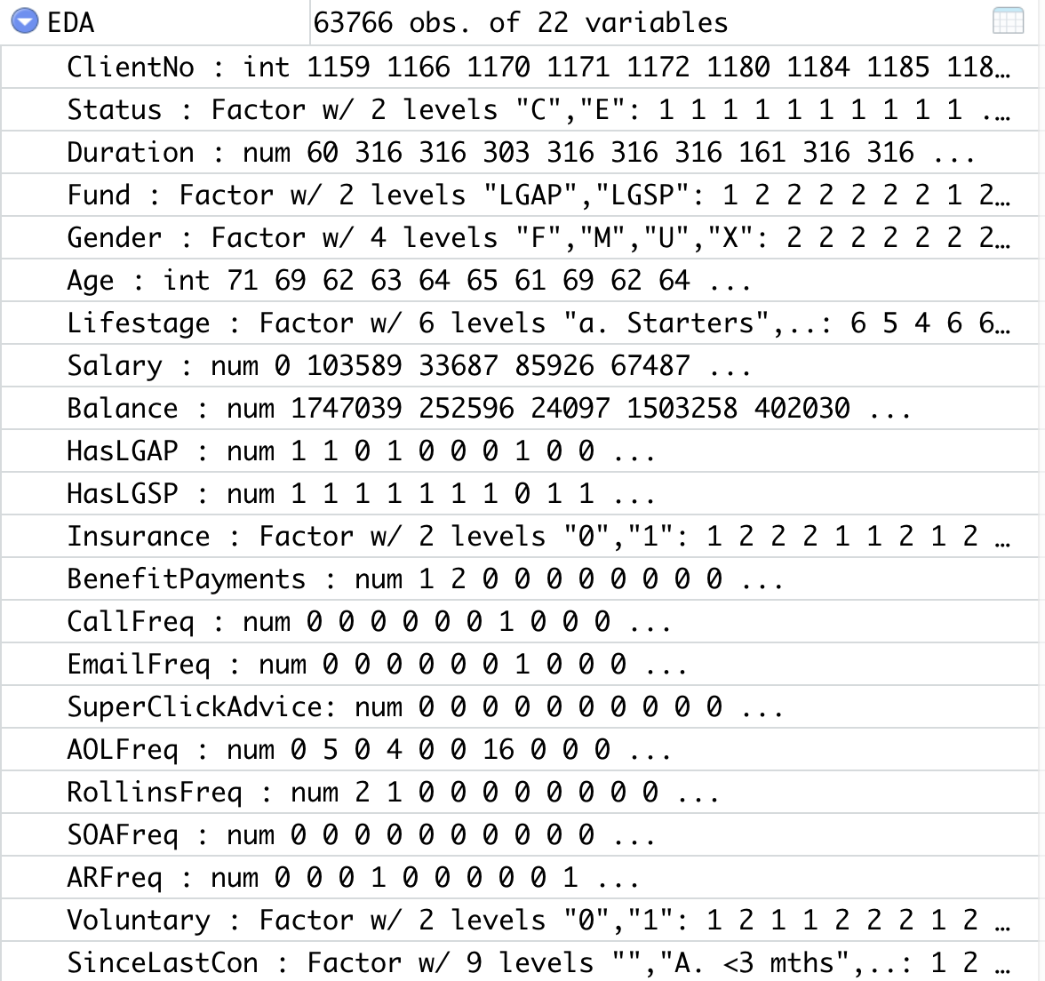
2. Feature Engineering
Final Dataset Overview
Demographic variables obtained from Member Data
Client activity aggregated as frequency within one year from extraction date or exit date
Filters used for Balance

Slide 9
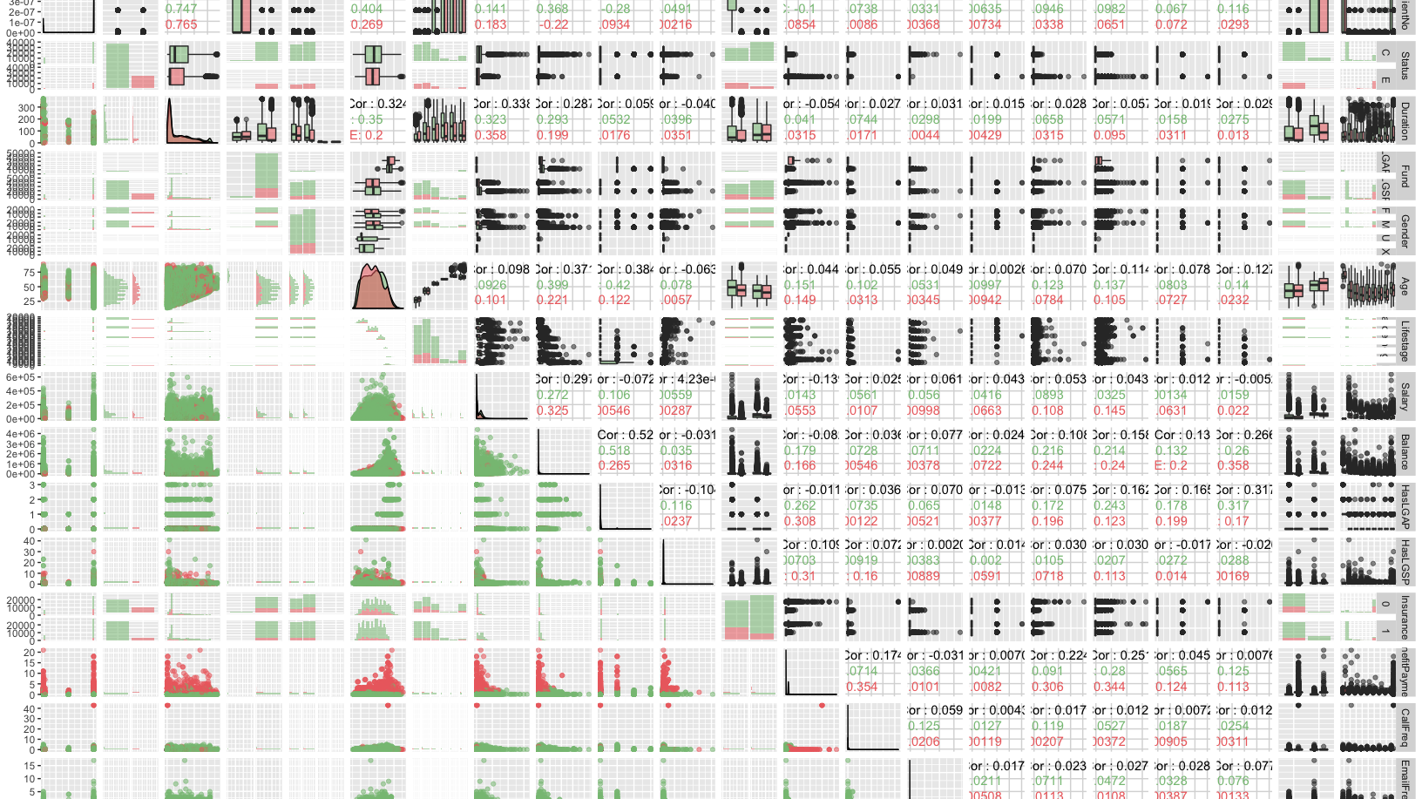
3. Exploratory Data Analysis
Pairwise plot between all variables
Explore client status’ distribution by all variables
Examine any outliers

Slide 10
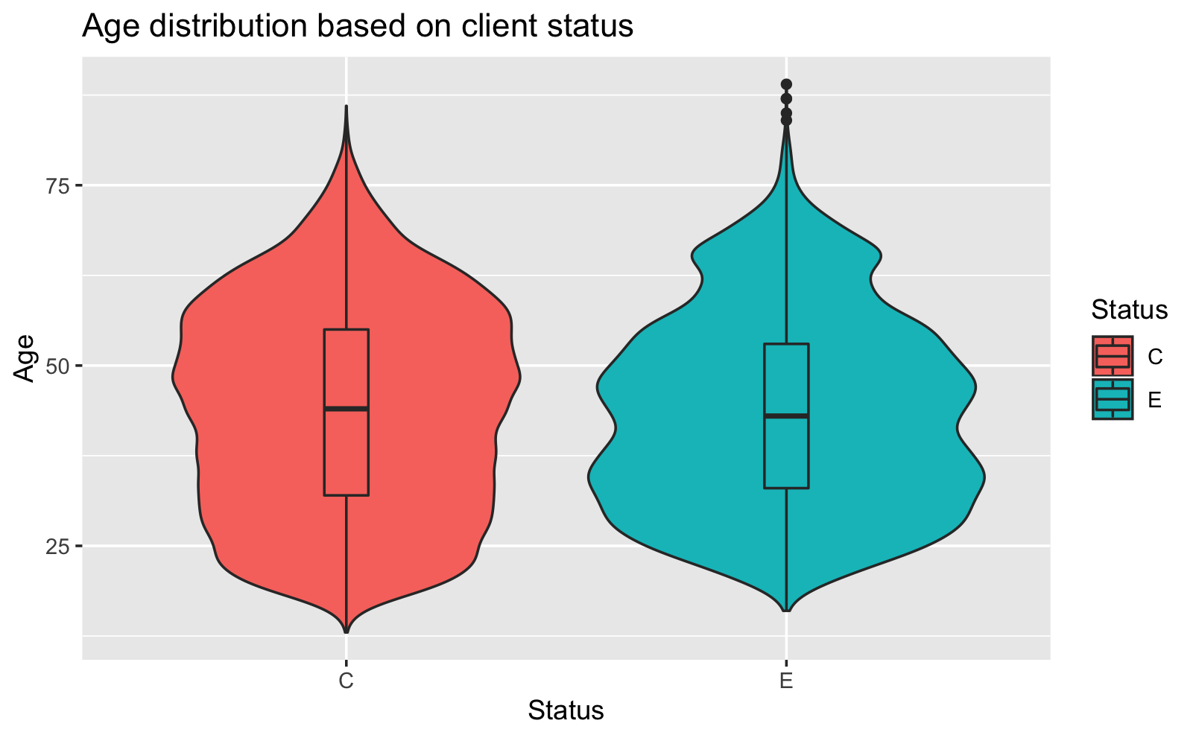
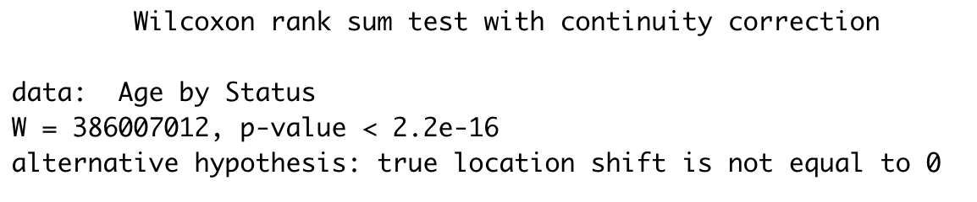

Slide 11
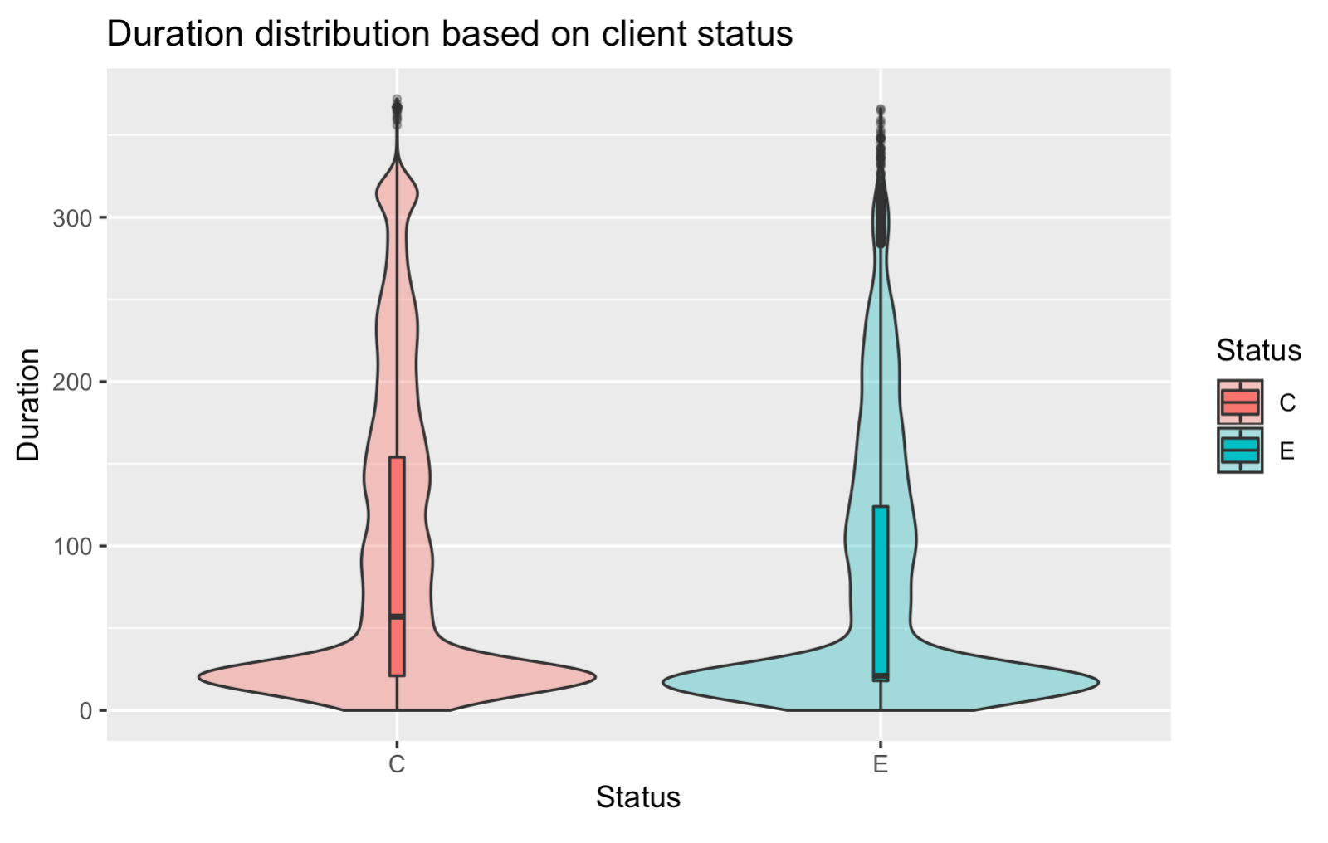
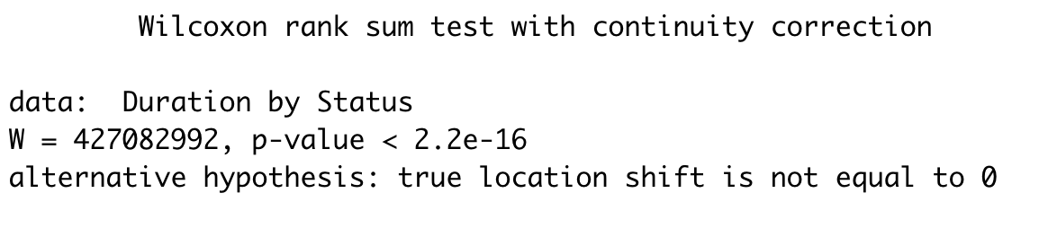

Slide 12
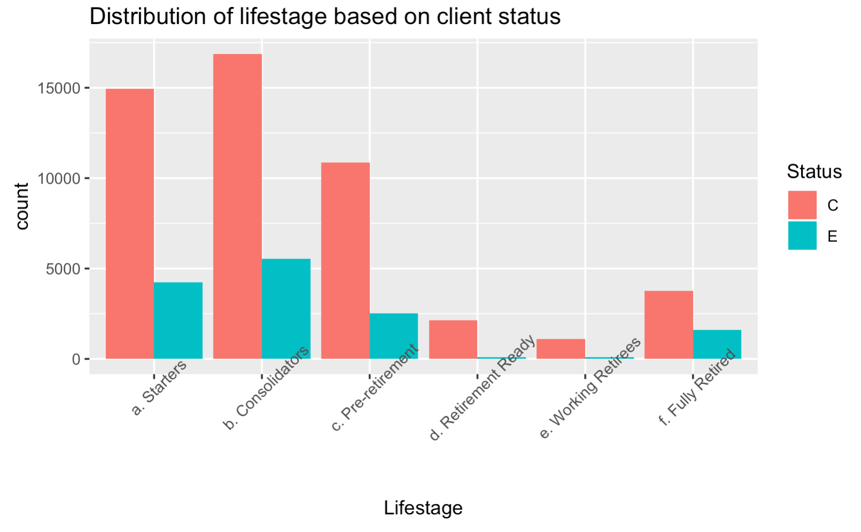
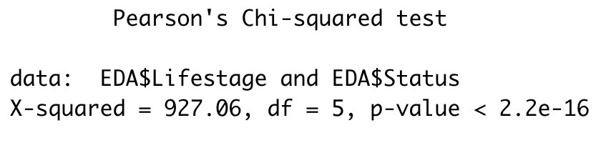

Slide 13
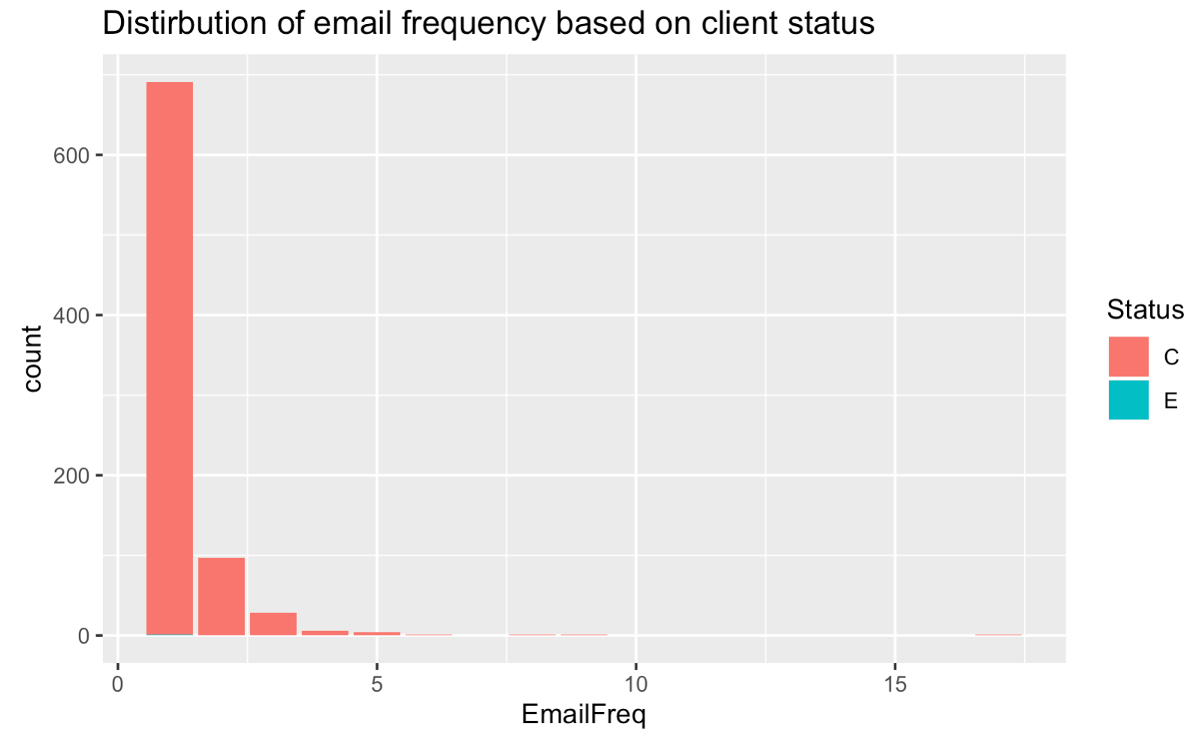
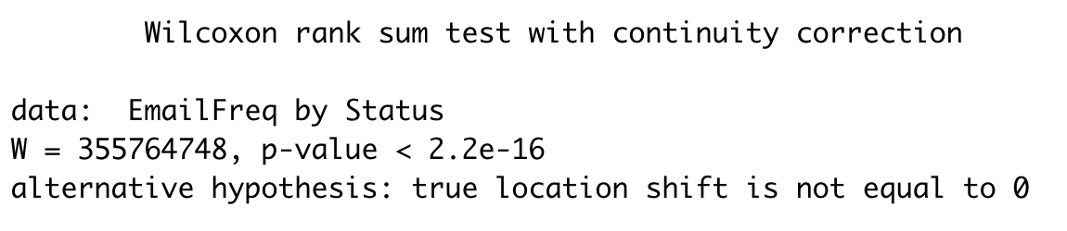

Slide 14
4. Modelling Part 1
Main dataset 65876 unique rows and 22 variables
Decision Tree
Random Forest
Variable Importance Plot
Other methods tried

Slide 15
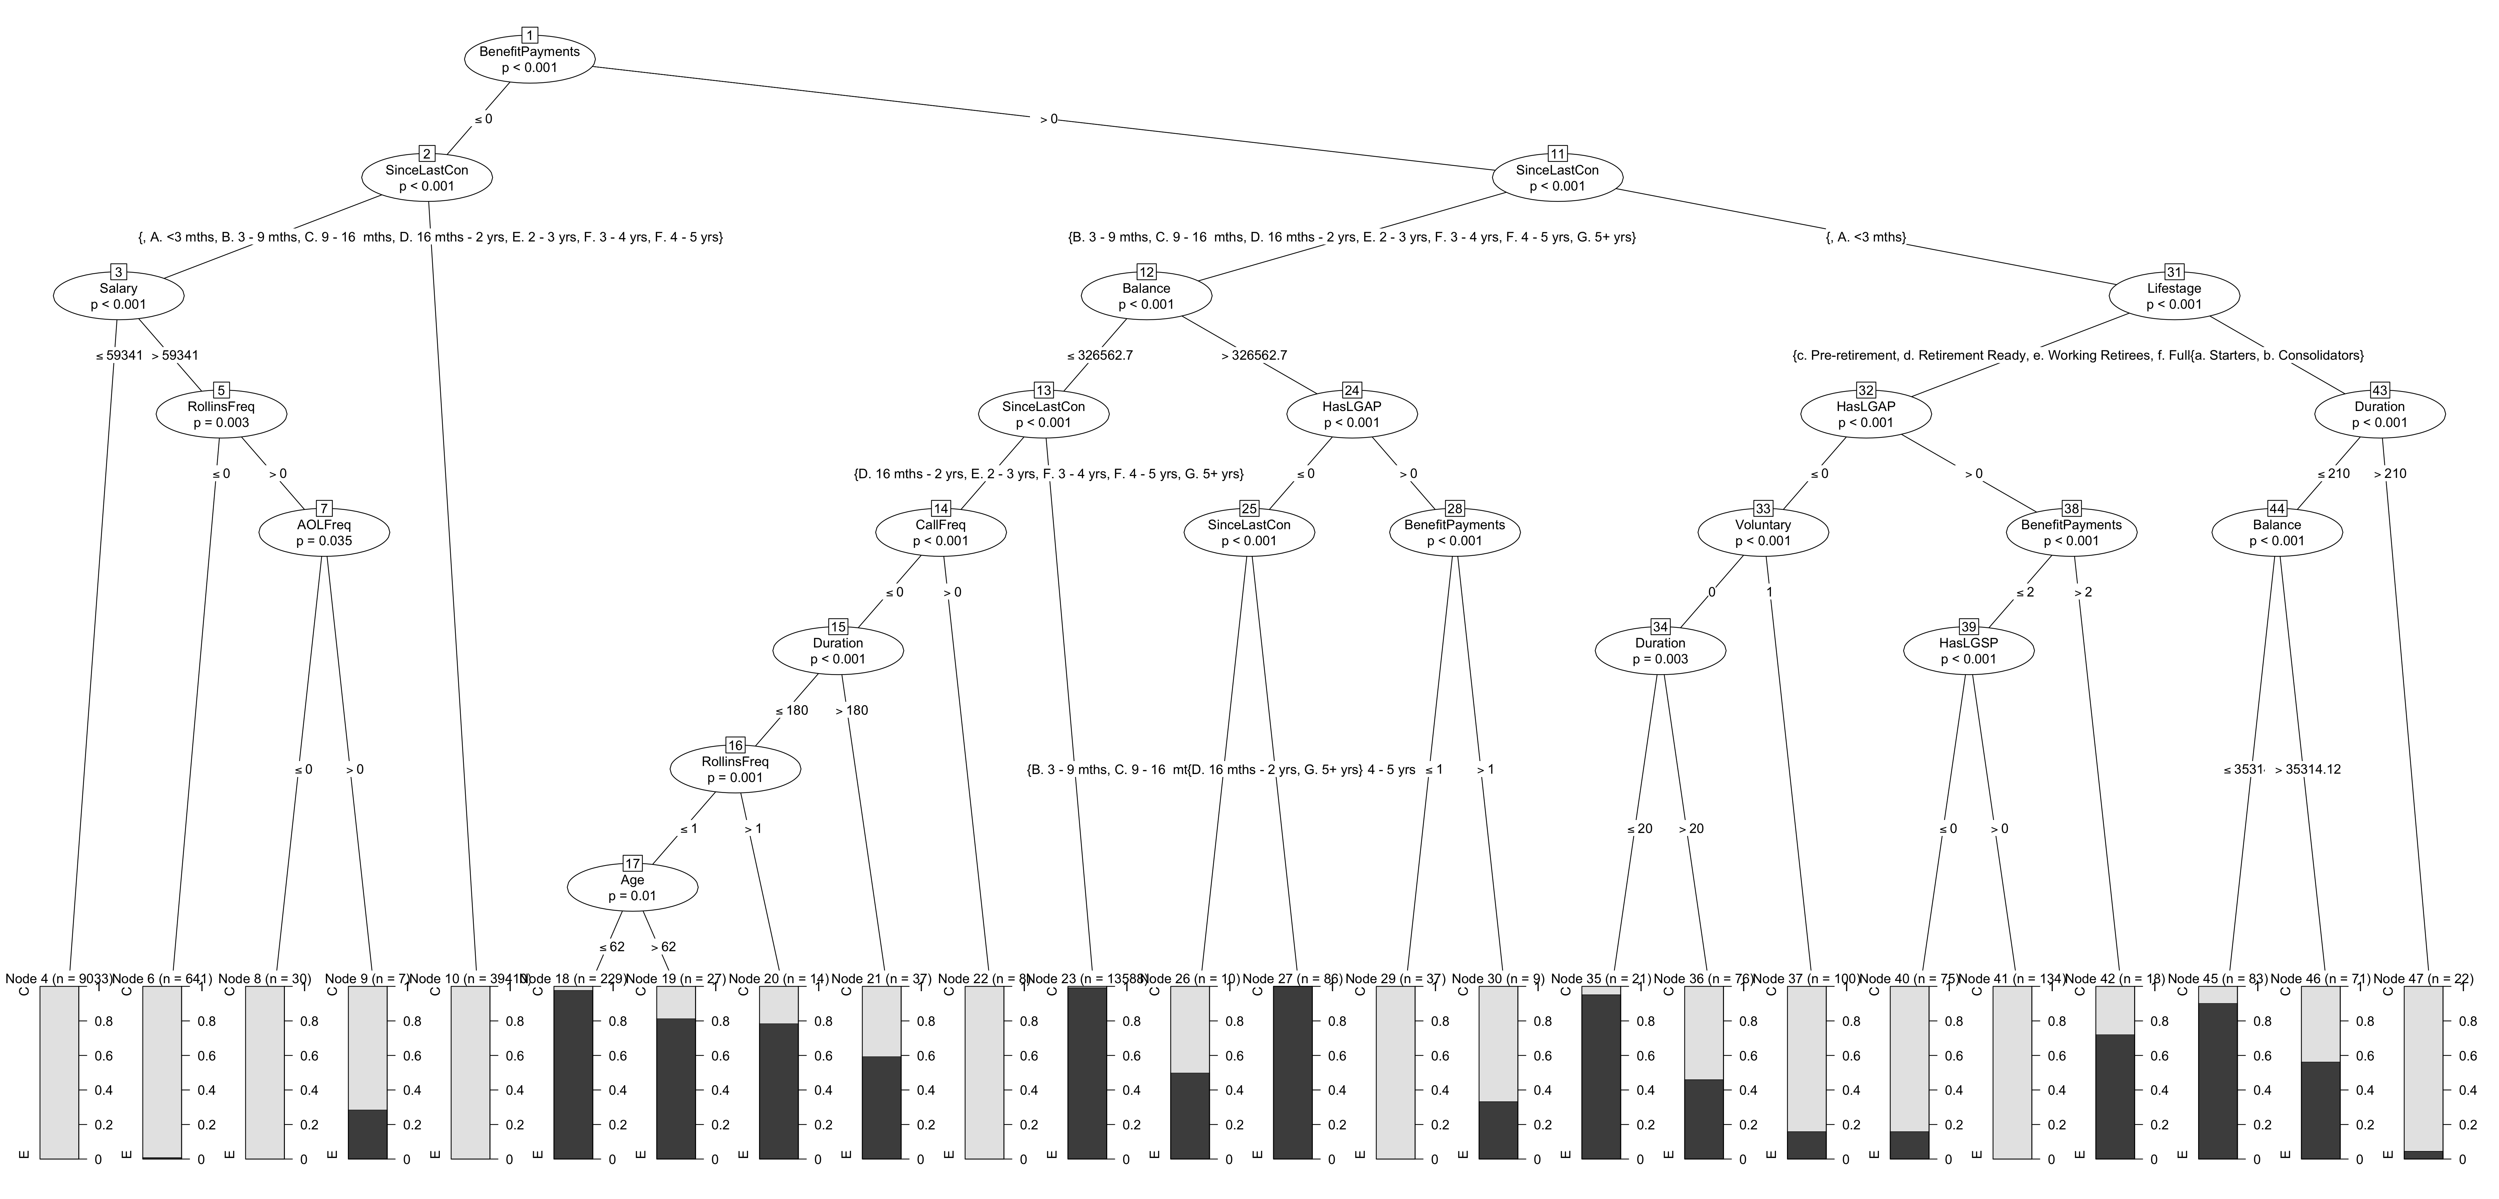
4.A. Decision Tree

Slide 16
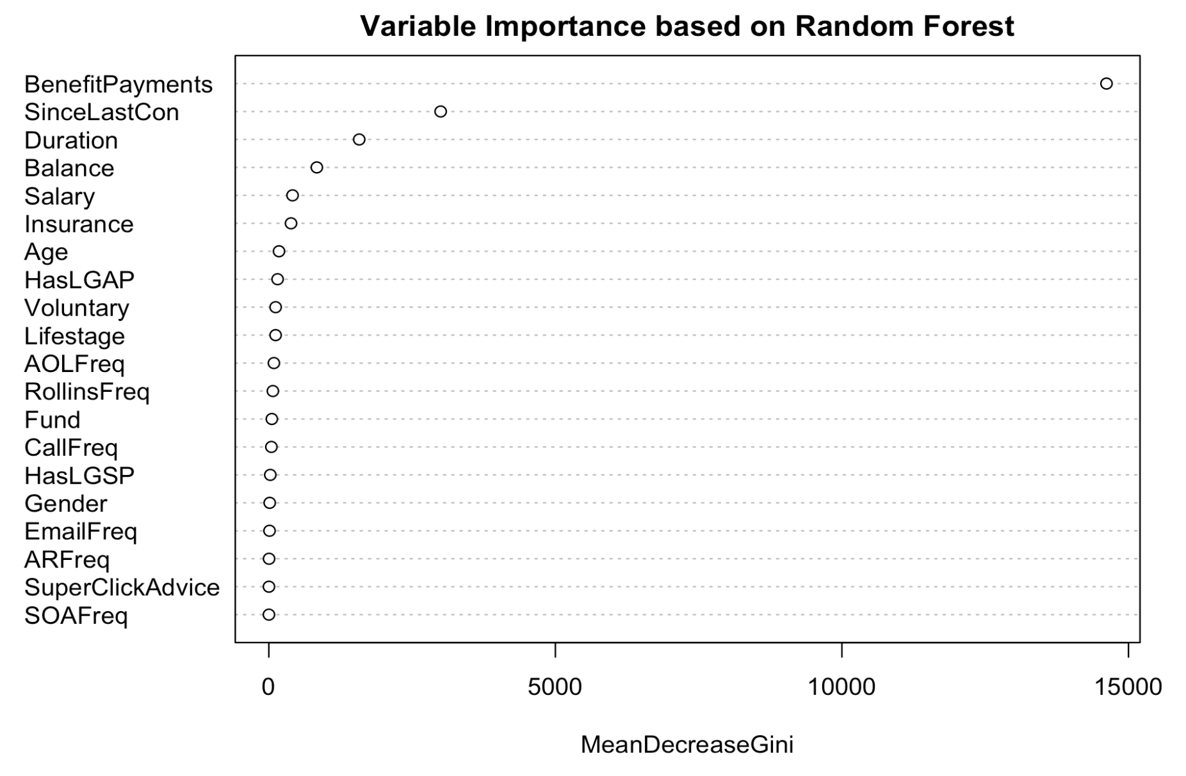
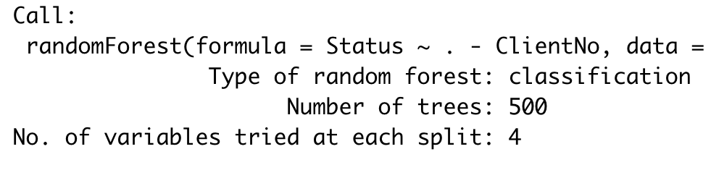
4.B. Random Forest

Slide 17
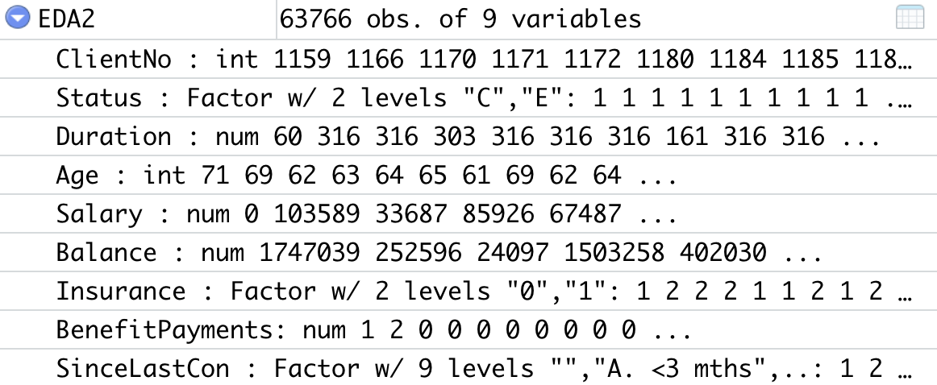
5. Modelling Part 2
Main dataset 65876 unique rows and 9 variables
Decision Tree
Random Forest
Variable Importance Plot
Confusion Matrix
Random Forest with Multiple Cross Validation

Slide 18
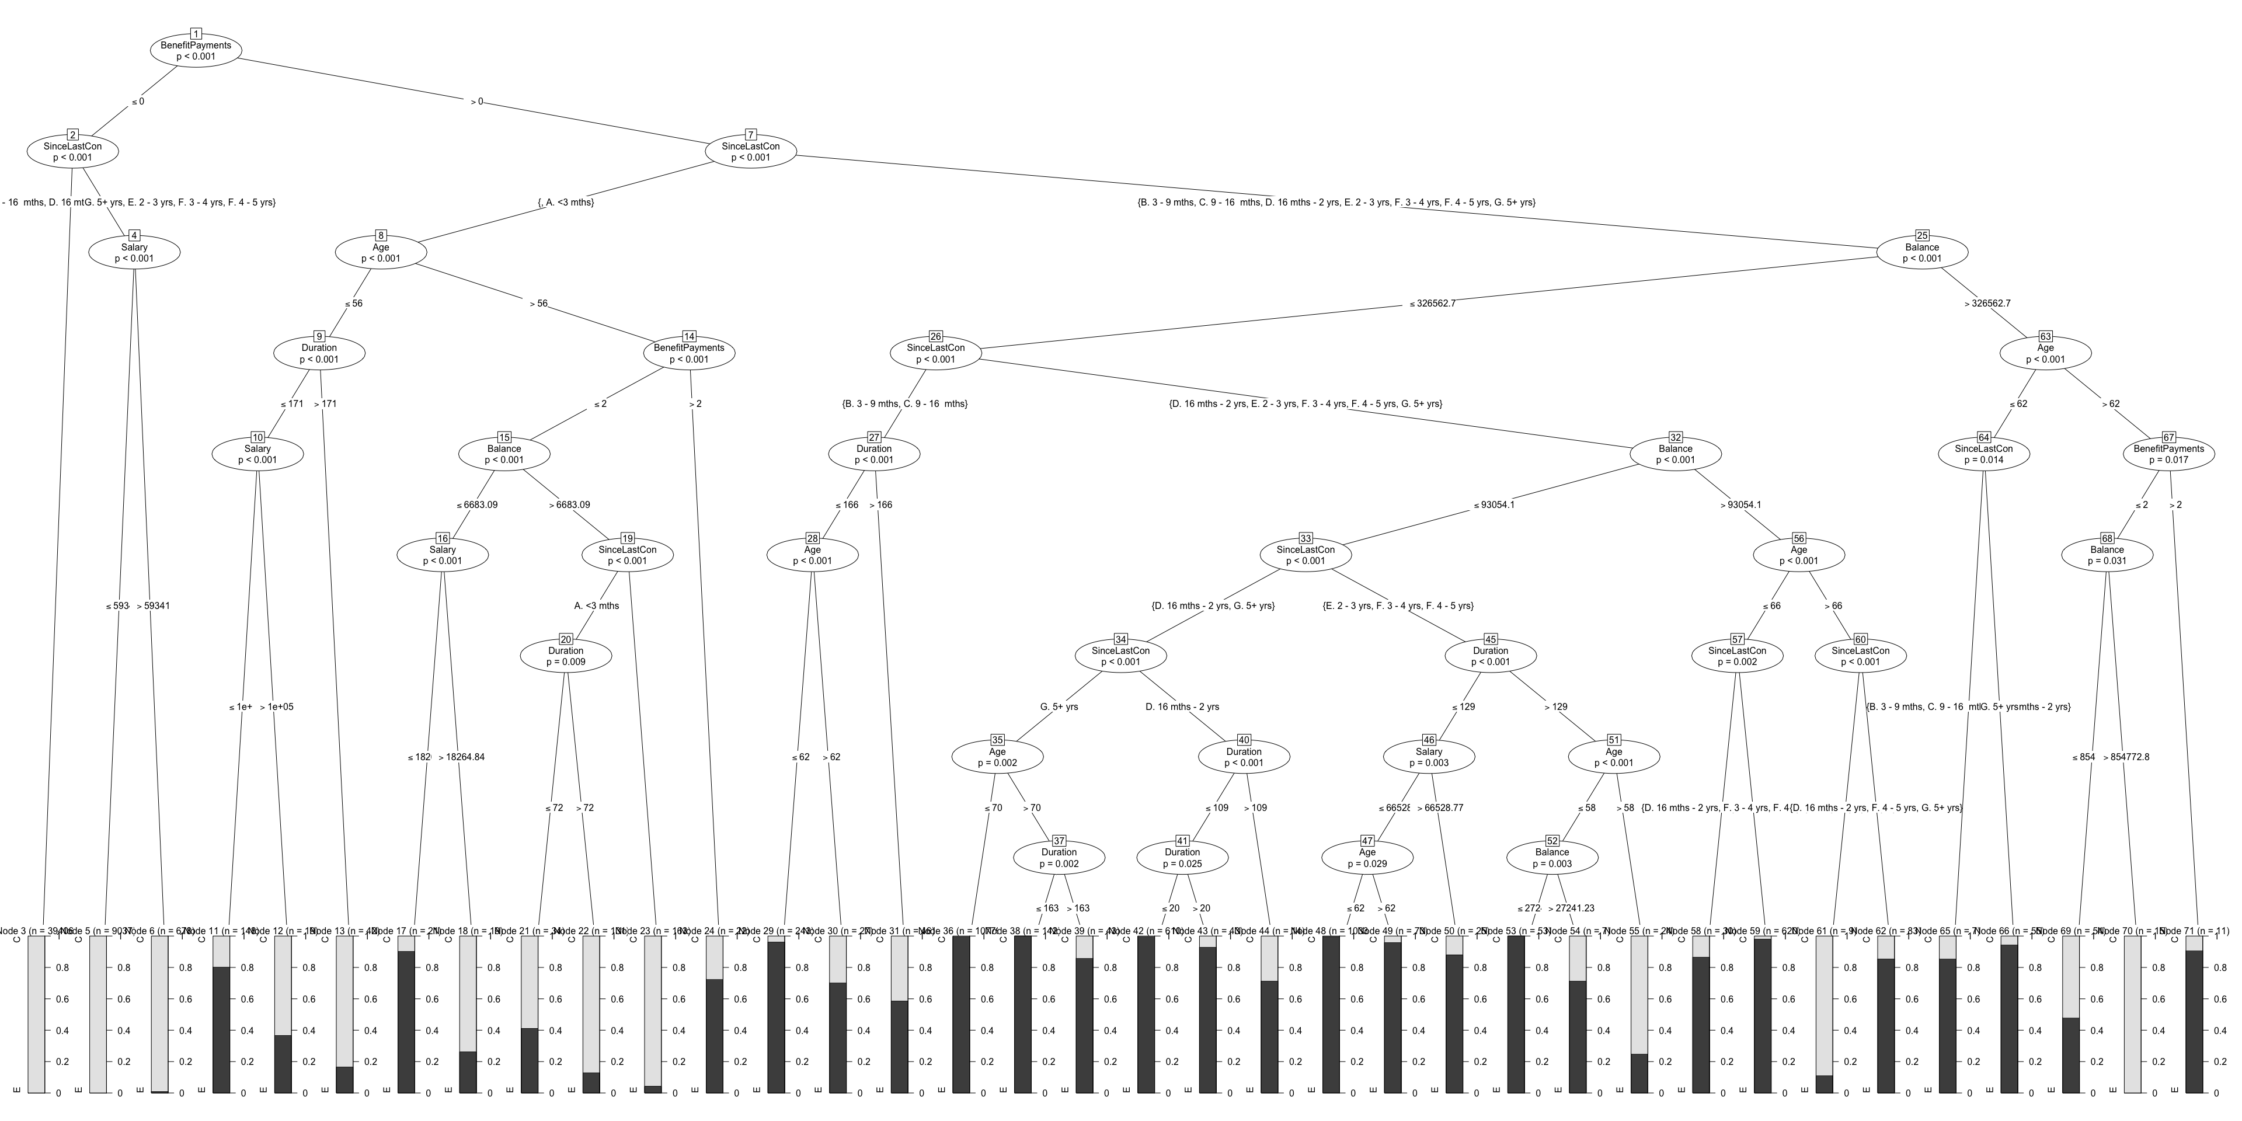
5.A. Decision Tree

Slide 19
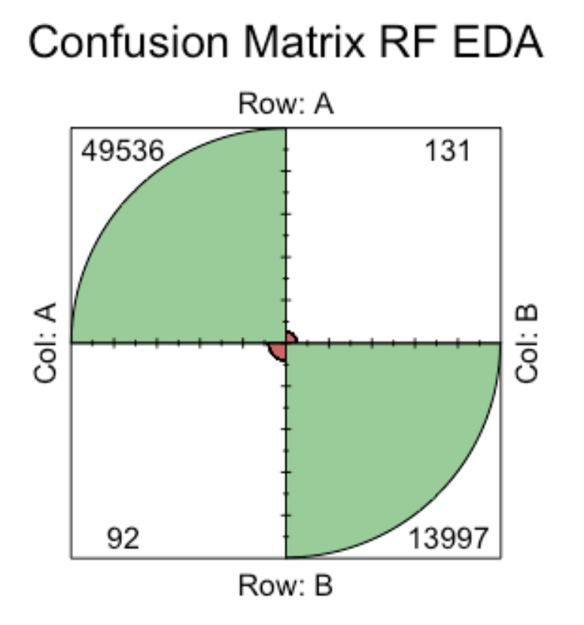
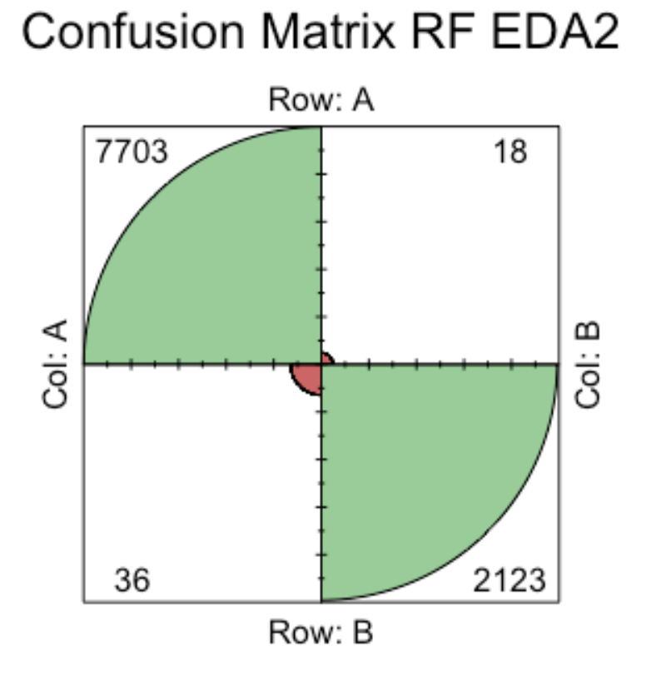
5.C. Confusion Matrix
predicted
 | C | E
C | 49536 | 131
E | 92 | 13997 | 0.35%
predicted
 | C | E
C | 7394 | 18
E | 22 | 2122 | 0.49%

Slide 20
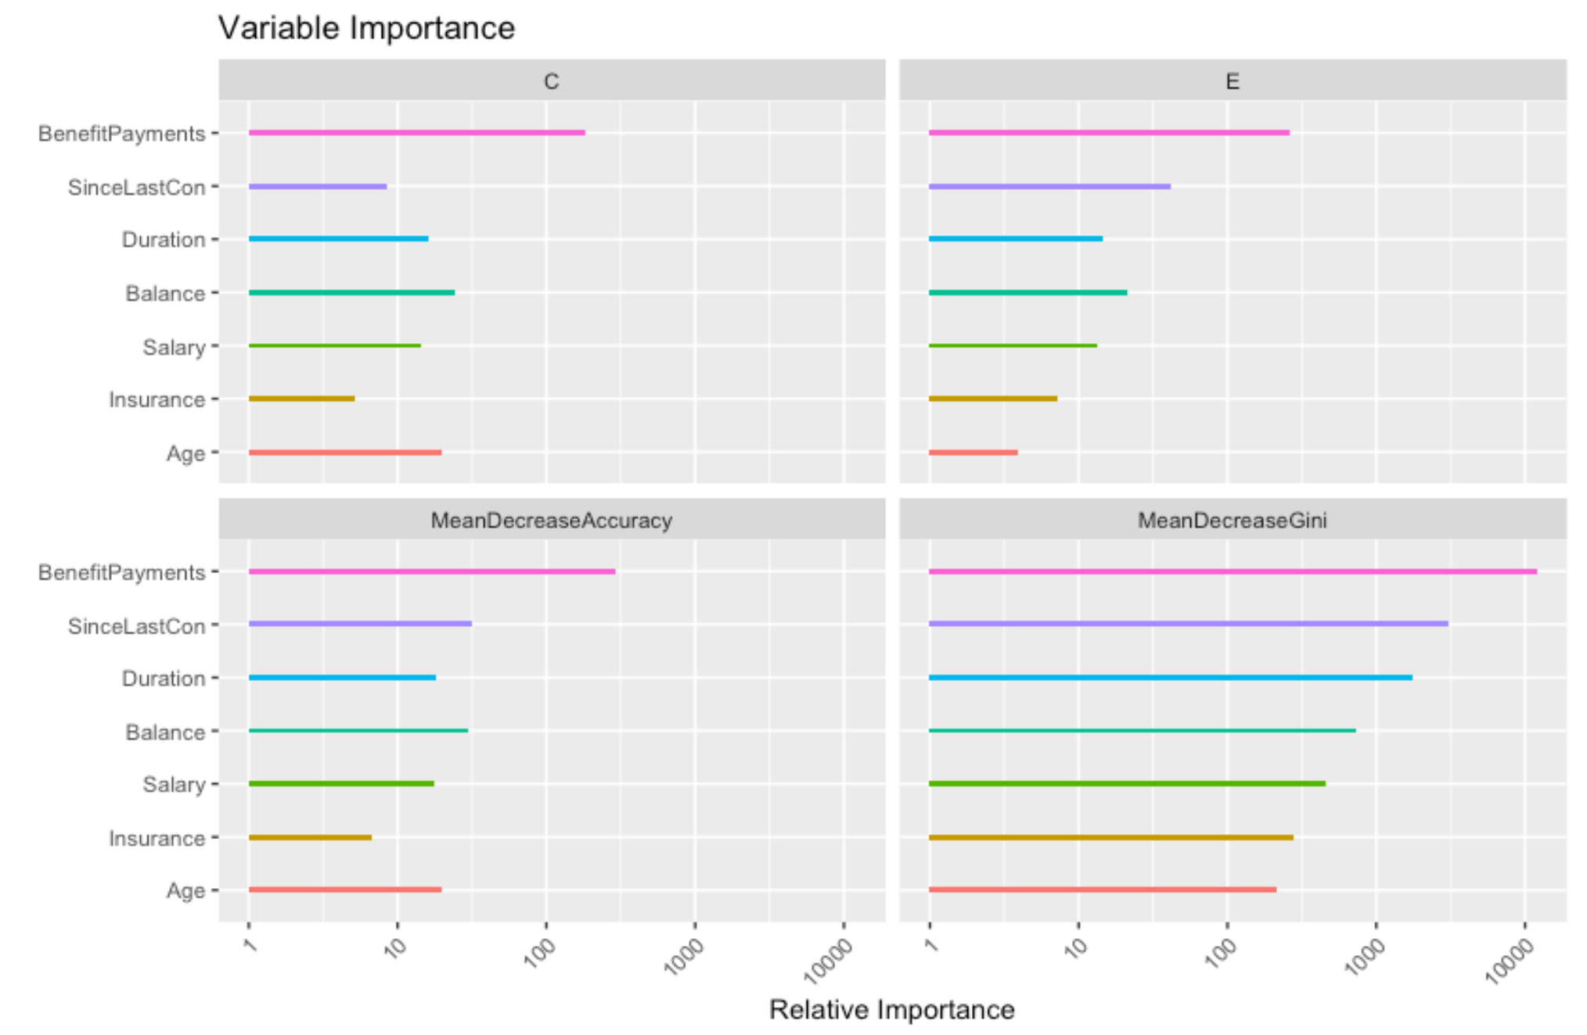
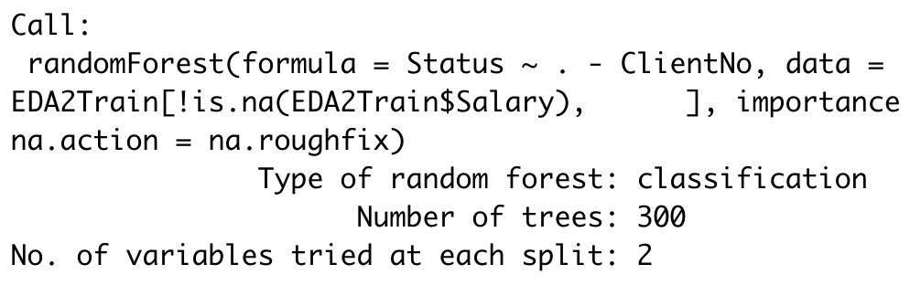
5.B. Random Forest
Previously:
Benefit Payments
Since Last Contribution
Duration
Balance
Salary
Insurance
Age

Slide 21

4. Results and Implementation
Many of the activity variables didn’t show much significance
Extract from Members and Balance Payments
Front end excel and back end R

Slide 22
5. Limitations
Only a little proportion of clients engaged in the extra services, if the proportion increases, maybe then these datasets will be more useful to the model (show more significance)
Call or email (1/3 from 2017 to 2019)
Client’s account Balance is recorded at one point in time
29th November 2019 for current clients
Exit date for exit clients
Can look at pattern over time

